Slide 1
Space and time analysis of Insertion Sorting
Goals:
Start using framework for describing and analyzing
Examine insertion sort algorithm
See how to describe algorithm in pseudocode
Begin using asymptotic notation (next page) to express running-time analysis
1

Slide 2
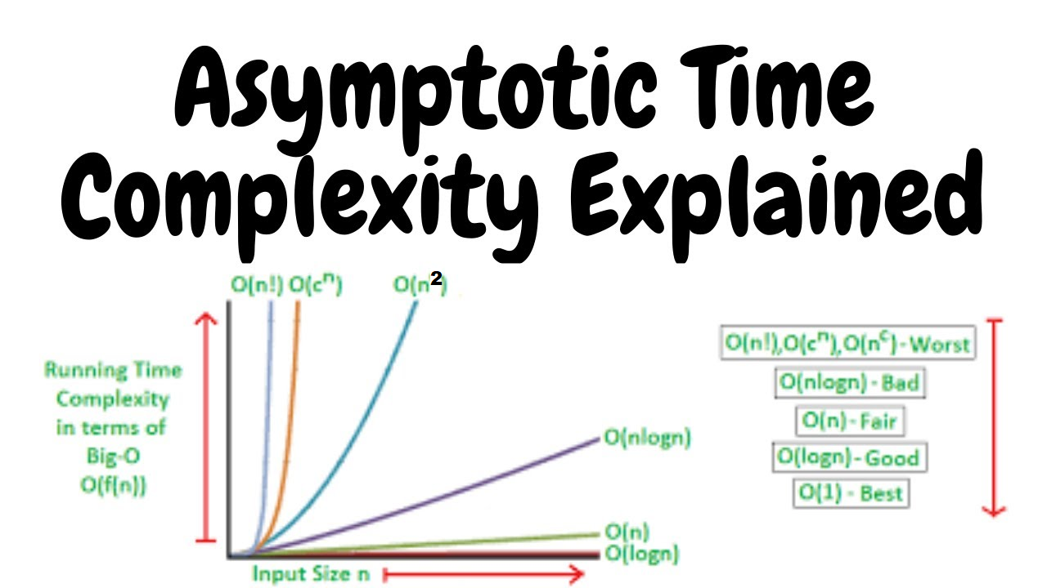

Slide 3
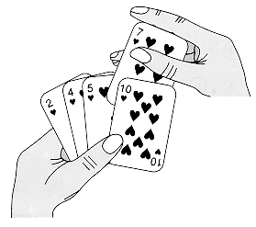
Insertion sort
Problem: to sort a sequence of numbers into nondecreasing order
Input: A sequence of n numbers
Output: A permutation (reordering) of the input sequence such that
3

Slide 4
Insertion sort
Pseudocode
That is similar in many respects to C, Pascal, or Java
Differences between pseudocode and real code
pseudocode is clear and concise to specify a given algorithm
Pseudocode is not typically concerned with issues of software engineering (data abstraction, modularity, error handling)
4

Slide 5
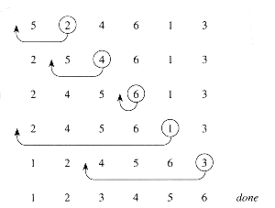
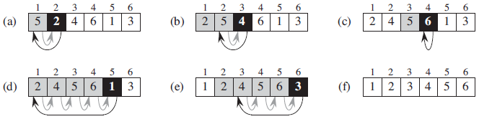
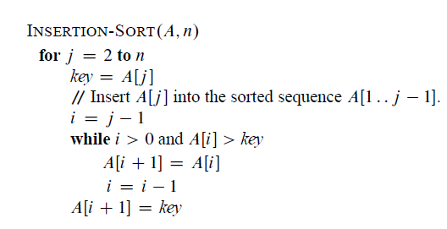

Insertion sort
INSERTION-SORT(A)
1 for( i = 2; i <=length[A]; i++) // loop header
2 { key = A[i]
3 // Insert A[i] into the sorted sequence A[1 .. i-1]
4 j←i-1
5 while( i > 0 && A[i] > key)
6 { A[i+1] = A[i]
7 i= i-1
8 }
9 A[i+1] = key
10 } // loop body below
Is the algorithm correct?
5

Slide 6
Loop invariants and the correctness of insertion sort
Loop invariants
Loop invariant: At the start of each iteration of for loop, the subarray A[1 .. j-1] consists of the elements originally in A[1 .. j-1] but in sorted order. A{5, 2, 4, 6, 1,3}
It can help us to understand why an algorithm is correct.
three properties about a loop invariant
Initialization: it is true prior to the first iteration of the loop.(base case)
Maintenance: if it is true before an iteration of the loop, it remains true before the next iteration. (inductive step) ( [i-1] true => [i] true )
Termination: When the loop terminates, the invariant show that the algorithms is correct. (stopping the “induction” when the loop terminates; the inductive step of mathematical induction is used infinitely.)
When the first two properties hold, the loop invariant is true prior to every iteration of the loop. It is similar to mathematical induction.

Slide 7
Loop invariants and the correctness of insertion sort
{5, 2, 4, 6, 1, 3}
three properties hold for insertion sort
Loop invariant: original A[1 .. j-1] is permuted to A’[1 .. j-1] but in sorted order
Initialization: j=2, A[1 .. j-1] consists of just the single A[1] , which is the original element in A[1] and is sorted. Obviously, the loop invariant holds prior to the first iteration of the loop.
Maintenance: A’[1 .. j-1] is in sorted order, sorting A[j] into A’[1 .. j-1], s.t. , obviously, it is sorted. The second property holds for the outer loop.
Termination: when j=n+1. A’[1 .. j-1] = A’[1 .. n] consists of the elements originally in A[1 .. n], but in sorted order. A’[1 .. n] is the entire array! Hence, the algorithm is correct.
7

Slide 8
Pseudocode conventions
Indentation indicates block structure.
The looping constructs (while, for, repeat) and the conditional constructs (if, then, else) have interpretations like those in Pascal, C.
“// ” or “ ”indicates a comment.
A multiple assignment i ←j←e is equivalent to j←e then i←j.
Variables are local to the given procedure.
Array elements access: A[i] ; A[1 .. j ] = < A[1], A[2],…, A[i]>
Compound data are typically organized into objects.
Parameters are passed to a procedure by value.
The Boolean operators “and” and “or” are short circuiting: for example, “ x and (or) y ”: whether evaluate y rely on the evaluating of x.
8

Slide 9
In class exercise 1:
1. Using the below figures as a model, illustrates the operation of insertion-sort on the array A={31, 41, 59, 26, 47, 58}
INSERTION-SORT(A)
1 for( j = 2; j <=length[A]; j++) // loop header
2 { key = A[j]
3 // Insert A[i] into the sorted sequence A[1 .. j-1]
4 i←j-1
5 while( i > 0 && A[i] > key)
6 { A[i+1] = A[i]
7 i= i-1
8 }
9 A[i+1] = key
10 } // loop body below
9

Slide 10
In class exercise answer:
1. Using the below figure as a model, illustrates the operation of insertion-sort on the array A={31, 41, 59, 26, 47, 58}
a.
31 | 41 | 59 | 26 | 47 | 58
Key=41
b.
31 | 41 | 59 | 26 | 47 | 58
Key=59
c.
31 | 41 | 59 | 26 | 47 | 58
Key=26
d.
26 | 31 | 41 | 59 | 47 | 58
Key=47
e.
26 | 31 | 41 | 47 | 59 | 58
Key=58
f.
26 | 31 | 41 | 47 | 58 | 59
10

Slide 11
In class exercise 2:
Rewrite the INSERTION-SORT procedure to sort into nonincreasing (descending order) instead of nondecreasing order (Increasing would be ascending). For instance: A={5, 2, 4, 6, 1, 3}; A= {6, 5, 4, 3, 2, 1}
INSERTION-SORT(A)
1 for( j = 2; j <=length[A]; j++) // loop header
2 { key = A[j]
3 // Insert A[i] into the sorted sequence A[1 .. j-1]
4 i←j-1
5 while( i > 0 && A[i] > key)
6 { A[i+1] = A[i]
7 i= i-1
8 }
9 A[i+1] = key
10 } // loop body below

Slide 12
In class exercise 2 answer:
Rewrite the INSERTION-SORT procedure to sort into nonincreasing (descending order) instead of nondecreasing order (Increasing would be ascending). For instance: A={5, 2, 4, 6, 1, 3}; A= {6, 5, 4, 3, 2, 1}
INSERTION-SORT(A)
1 for( j = 2; j <=length[A]; j++) // loop header
2 { key = A[j]
3 // Insert A[i] into the sorted sequence A[1 .. j-1]
4 i←j-1
5 while( i > 0 && A[i] < key)
6 { A[i+1] = A[i]
7 i= i-1
8 }
9 A[i+1] = key
10 } // loop body below

Slide 13
In class exercise 3:
Consider the searching problem:
Input: A sequence of n numbers A={a1,a2,....an} and a value v.
Output: An index i such that v=A[i] or the special value NIL if v does not appear in A. Write pseudocode for linear search, which scans through the sequence, looking for v. Using a loop invariant, prove that your algorithm is correct. Make sure that your loop invariant fulfills the three necessary properties.

Slide 14
In class exercise 3 answer:
Algorithm for exercise 3 :
0: Linear-Search(A, v)
1: i = NIL //the special value NIL if v does not appear in A
2: for j = 1 to A.length do
3: if A[ j ] = v then
4: i = j
5: return i
6: end if
7: end for
8: return i

Slide 15
Analyzing algorithms
Analyzing an algorithm means predicting the resources
Resources:
memory (space)
communication bandwidth (The maximum amount of data transmitted over an internet connection in a given amount of time)
primary concern computer hardware
computational time (in CPU, I/O, …)
In our class Space and time Complexity analysis will be addressed
15

Slide 16
Analyzing algorithms
RAM model: Algorithms will be implemented as computer programs.
RAM, a generic one-processor, instructions are executed one after another, with no concurrent operations.
RAM contains instructions commonly
Arithmetic (add, subtract, multiply, divide, remainder, floor, ceiling)
Data movement (load, store, copy)
Control (conditional and unconditional branch, subroutine call and return)
Each such instruction takes a constant amount of time.
16

Slide 17
Analyzing algorithms
Analyzing a simple algorithm can be a challenge
Mathematics required: combinatorics, probability theory, algebraic skill
An ability to identify the most significant terms in a formula
Summarizing an algorithm in simple formulas
17

Slide 18
Analyzing algorithms
Running time of a program is described as a function of the size of its input.
input size n: number of items in the input, depends on the problem
sorting array A: n = length of A
graph: n can be the numbers of vertices and edges
Running time T(n): on a particular input, the number of primitive operations or “steps” executed
The steps are machine-independent
A constant amount of time c_{i} (constant) is required to execute the ith line pseudocode

Slide 19
Analysis of insertion sort
INSERTION-SORT(A) cost Total times
1 for( j = 2; j <=length[A]; j ++) c₁ c_{1 *} n
2 { key = A[j] c₂ c_{2 *} (n-1)
3 // Insert A[j] into the sorted sequence A[1 .. j-1] c₃=0 c₃*(n-1)
4 i = j-1 c₄ c_{4 *} ( n-1)
5 while( i > 0 && A[i] > key) c₅
6 { A[i+1] = A[i]
7 i = i-1 c₆
8 } c₇
9 A[i+1] = key c₈ c₈ * (n-1)
10 }
Comp
C₅ *
Shifting right
C₆ *
C₇ *

Slide 20
Best case
i=j-1
while (i>1 && array[i]>key) C5
array[i+1]=array[i]; C6
i=i-1; } C7
A[i+1] = key C8
j
1 | 2 | 3 | 6 | 8
Comp=1; shifting=0
C5 - comp
comp | j=2 | j=3 | j=4 | j=n | Total
min | 1 | 1 | 1 | 1 | n-1
max | 1 | 2 | 3 | n-1 | n(n+1)/2
Between case
i=j-1
j
1 | 2 | 3 | 6 | 4
1 | 2 | 3 | 4 | 6
C6 - shifting
Comp=2; shifting=1
shifting | j=2 | j=3 | j=4 | j=n | Total
min | 0 | 0 | 0 | 0 | 0
max | 1 | 2 | 3 | n-1 | n(n+1)/2
Worst case
i=j-1
j
1 | 2 | 3 | 6 | 0
C7 – I decrementing
0 | 2 | 3 | 4 | 6
shifting | j=2 | j=3 | j=4 | j=n | Total
min | 0 | 0 | 0 | 0 | 0
max | 1 | 2 | 3 | n-1 | n(n+1)/2
Comp=4; shifting=4

Slide 21
Space and time analysis of Insertion Sorting
Best case time complexity (run time) – O(n)
Worst case time complexity (run time) – O(n²)
Space complexity: array, 3 new variables (i, j, key); when size n increase, 3 new variables would not change. So, space complexity is: O(1)

Slide 22
Analysis of insertion sort
Even for inputs of a given size, an algorithm’s running time may depend on which input of that size is given.
The best case occurs if the array is already sorted. For each j = 2, 3, …, n, A[i] ≤ key in line 5 when i has its initial value of j-1. Thus t_{j}=1, and the best-case running time is
It is thus a linear function of n.
22

Slide 23
Analysis of insertion sort
An algorithm’s running time may depend on factual input.
The worst-case results if the array is in reverse sorted order. We must compare each element A[j] with each element in the entire sorted subarray A[1 .. j-1], and so t_{j}=j. Noting that
then
It is thus a quadratic function (n²) of n.
23

Slide 24
Worse-case and average-case analysis
The best case, in which the input array was already sorted {1,2,4, 6, 8}
We usually concentrate on finding the worst-case running time (input array was reverse order {9, 8, 7, 6, 5, 4, 3, 2},the longest running time for any input of size n ). Three reasons:
The worst-case running time of an algorithm is an upper bound on the running time for any input.
The worst case occurs often. (in searching a database)
The “average case” is often roughly as bad as the worst case. (suppose that we randomly choose n numbers and apply insertion sort.)
24

Slide 25
Order of growth
Rate of growth (order of growth)
the more simplifying abstraction.
considering only the leading term of a formula (e.g., an² of an²+bn+c), since the lower-order terms are relatively insignificant for large n.
ignoring the leading term’s constant coefficient, since constant factors are less significant than the rate of growth in determining computational efficiency for large inputs.
Thus, the insertion sort has a worst-case running time of Θ(n²)
Usually, one algorithm is more efficient than another if its worst-case running time has a lower order of growth (small inputs exception, e.g., 10nlgn vs 2n² ).
Express the function: n³ /1000 - 100n² - 100n +3 in terms of Θ notation
Ans: Θ (n³)
Big O is giving only upper asymptotic bound, while big Theta is also giving a lower bound. Everything that is Theta(f(n)) is also O(f(n)), but not the other way around. T(n) is said to be Theta(f(n)), if it is both O(f(n)) and Omega(f(n))

Slide 26
Thanks!
Have a wonderful Labor day!
Reminder 1: Assignment 1 is due next Wed.
Reminder 2: Bring your laptop to Sep. 4’s class

